Slide 1
Walking the Walk
Turning Qualitative Text into Quantitative Results

Slide 2

WALKING THE WALK: AN NLP PROJECT
2021
OVERVIEW
The process of finding a job is quite an undertaking with many factors to consider. Ratings from current and former employees can play a key role in whether or not a candidate chooses to apply. In this project, I attempt to close the gap using a translation of qualitative reviews into a quantitative metric that, when combined with machine learning can predict the review score currently available through sites like glassdoor.
02

Slide 3
WALKING THE WALK: AN NLP PROJECT
2021
Summary of Approach
The 4 Phases
DATA ACQUISITION
EDA
PROCESSING
MODEL
Web scraped 14k+ reviews from 150 companies of various industries and ratings from the Glassdoor site.
During this step non-text and text features was cleaned, recategorized, and visualized..
Prepare the text for modeling through NLP. This involves steps like removing stop words, removing punctuation, stemming, and vectorizing.
Laslty, I tested several models in order to find the best fit for my data.
03

Slide 4

WALKING THE WALK: AN NLP PROJECT
2021
Looking At the Target
02

Slide 5
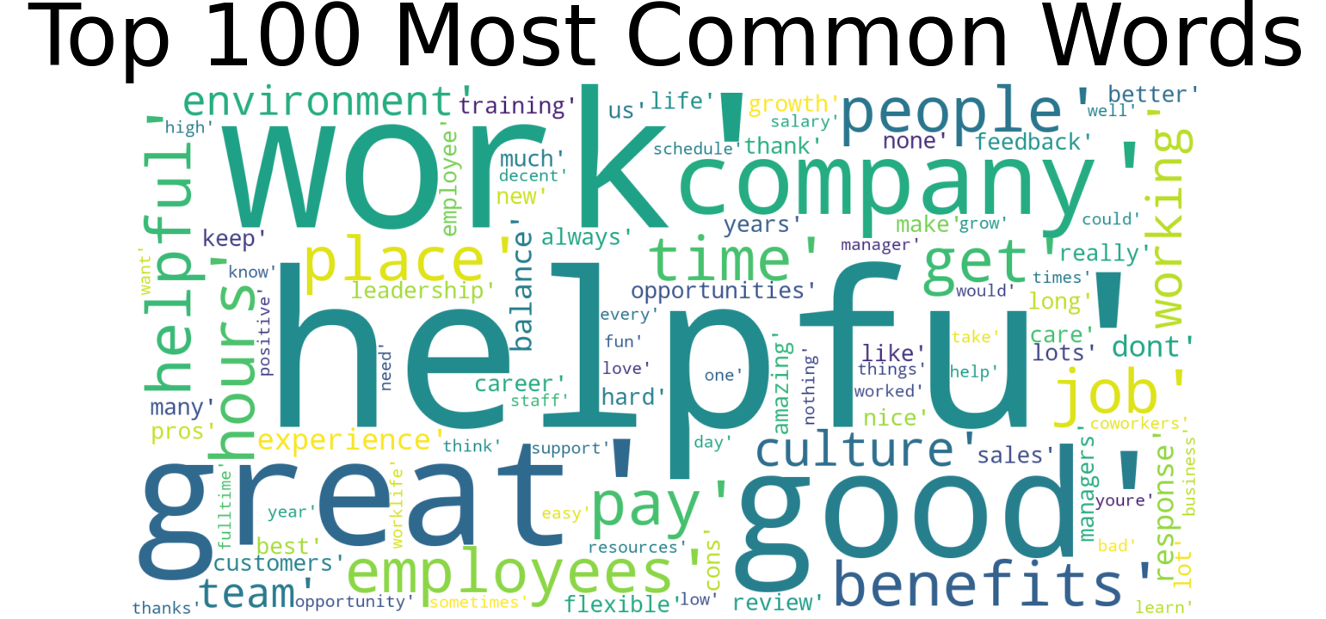
WALKING THE WALK: AN NLP PROJECT
2020
We can see that 'helpfu' is the most popular word throughout all the reviews. We can surmised that reviewers had a lot to say about what they did and did not find helpful at the places of work.
13

Slide 6
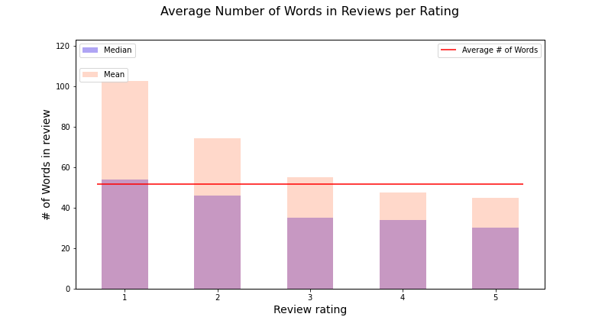
WALKING THE WALK: AN NLP PROJECT
2020
The Worse The Rating...
Another interesting find was that the lower rating the larger the average word count. The worse the experience the more there was to say about it.
08

Slide 7
WALKING THE WALK: AN NLP PROJECT
2021
Model Tests
KNN
RANDOM FOREST
LIGHTGBM
The KNN Model was the worst performer resulting in an only 45% accuracy.
Random forest performed very near my best performer with 58% accuracy.
Light Gradient Boosted Machine also resulted in a 58% accuracy.
09

Slide 8
WALKING THE WALK: AN NLP PROJECT
2021
59%
XGBOOST MODEL
ACCURACY
10

Slide 9
WALKING THE WALK: AN NLP PROJECT
2021
Conclusion
Next Step
This indicates that machine learning could be a better way to score company reviews and this the overall company rating versus relying on a self reported score.
For my next steps I will try to improve on my two best models using grid search to see if I can improve accuracy scores.
11

Slide 10

Contact Me
I'd love to connect.
LINKEDIN
https://www.linkedin.com/in/anjcray/
EMAIL ADDRESS
dataonatangent@gmail.com
GITHUB
https://github.com/DataOnATangent
12

